Slide 1
Operating Systems
David Hay

Slide 2
Multiple Processes
0000…
Proc 1
Proc 2
Proc n
code
…
Static Data
heap
OS
stack
1000…
code
sysmode
0
Process 2 is resident in the CPU
Static Data
Base
1000 …
heap
Bound
0100…
stack
1100…
uPC
xxxx…
code
3000…
PC
0001…
Static Data
regs
heap
00FF…
…
stack
3080…
FFFF…

Slide 3
Multiple Processes
0000…
Proc 1
Proc 2
Proc n
code
…
Static Data
heap
OS
stack
Process 1 is resident in the CPU
1000…
code
sysmode
0
Static Data
Base
3000…
heap
Bound
0080…
stack
1100…
uPC
xxxx…
code
3000…
PC
0032…
Static Data
regs
heap
003F…
…
stack
3080…
FFFF…

Slide 4
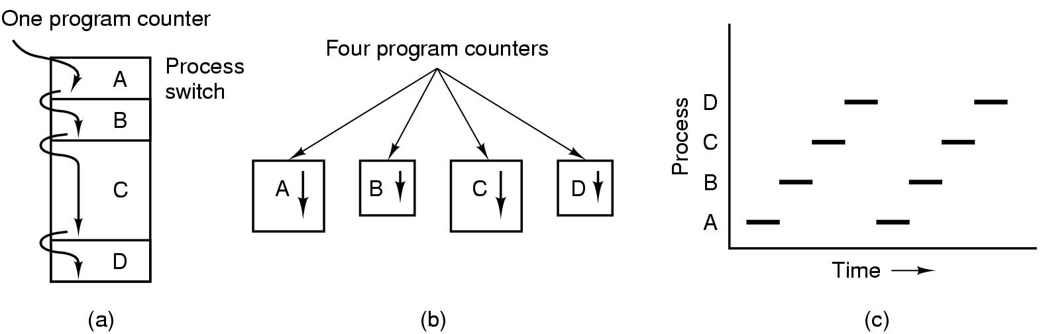
A process is a program in execution
(a) Multiprogramming of four programs
(b) Conceptual model of 4 independent, sequential processes
(c) Only one program active at any instant

Slide 5
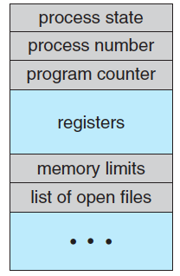
Process Control Block (PCB)
How the process is represented in the OS
Context
Additional OS information needed:
Memory management
Accounting information
I/O status information

Slide 6
The Rest of the Process’s State
PCB (Process Control Block)
Process ID
Process state data
Including a snapshot of all the CPU registers the last time the process was running
Information for calculating the process’s priority relative to other processes
Information about the user running the process, used to decide the process’s access rights
Can be many more, and can be listed in other operating system tables:
GUI parameters
Open files that are used for input and output
Communication channels to other processes / machines

Slide 7
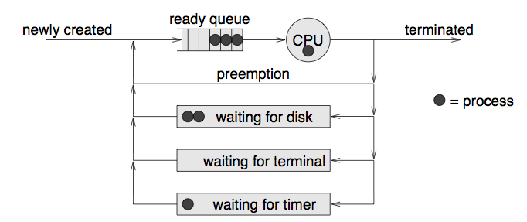
The Life-cycle of a Process
As a process executes, it changes state
new: The process is being created
running: Instructions are being executed
waiting: The process is waiting for some event to occur
ready: The process is waiting to be assigned to a processor
terminated: The process has finished execution

Slide 8
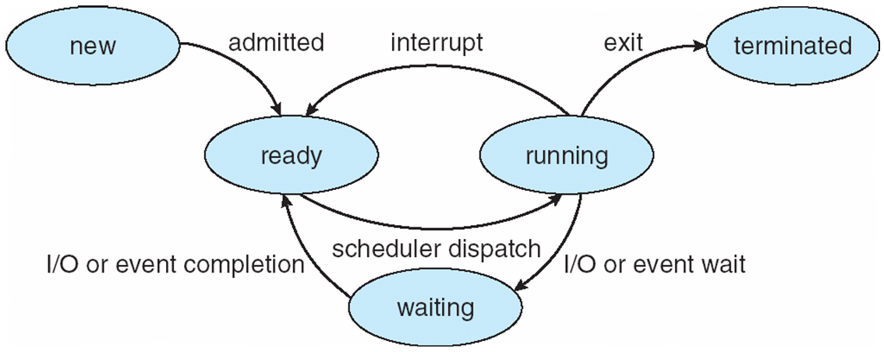
Diagram of Process State
a.k.a. Blocked

Slide 9
Scheduling
Which process should get to run on the CPU and for how long?

Slide 10
A Scheduler and a Dispatcher
CPU Scheduler: Decide which process should run on the CPU (and sometimes for how long)
“Short-term scheduling”; tens/hundreds times a second
Dispatcher: The module responsible on executing the CPU scheduler decisions:
Context switch
Switching back to user mode
Notes:
Dispatcher needs to be as fast as possible.

Slide 11
Process Creation
System initialization
Execution of a process creation system call
fork()
User request to create a new process
Double click on an icon, typing a command
Initiation of a batch job

Slide 12
Process Termination
Normal exit (voluntary)
Error exit (voluntary)
The process discover a fatal error :
cc foo.c when no file foo.c
Fatal error (involuntary)
Dividing by zero
Killed by another process (involuntary)
More on this later

Slide 13
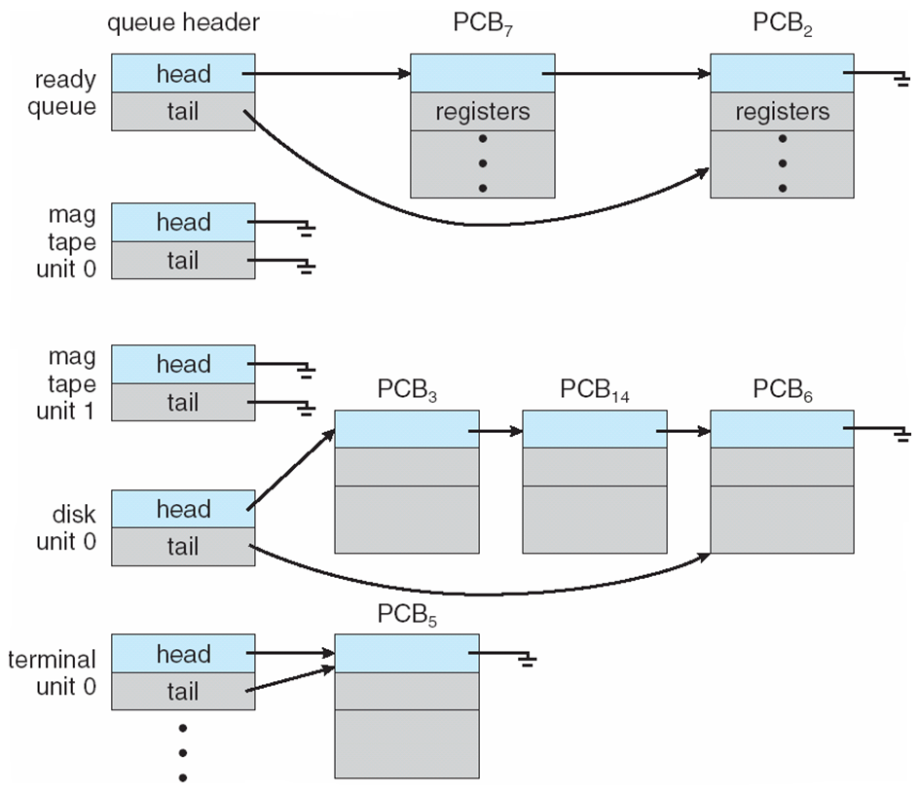
Ready Queue And Various I/O Device Queues
IO
Dev
IO
Dev

Slide 14
Context Switch between Processes
Save processor context, including program counter and other registers
Update the PCB with the new state and any accounting information
Move PCB to appropriate queue - ready, blocked/waiting
Select another process for execution
Update the PCB of the process selected
Update memory-management data structures
Restore context of selected process

Slide 15
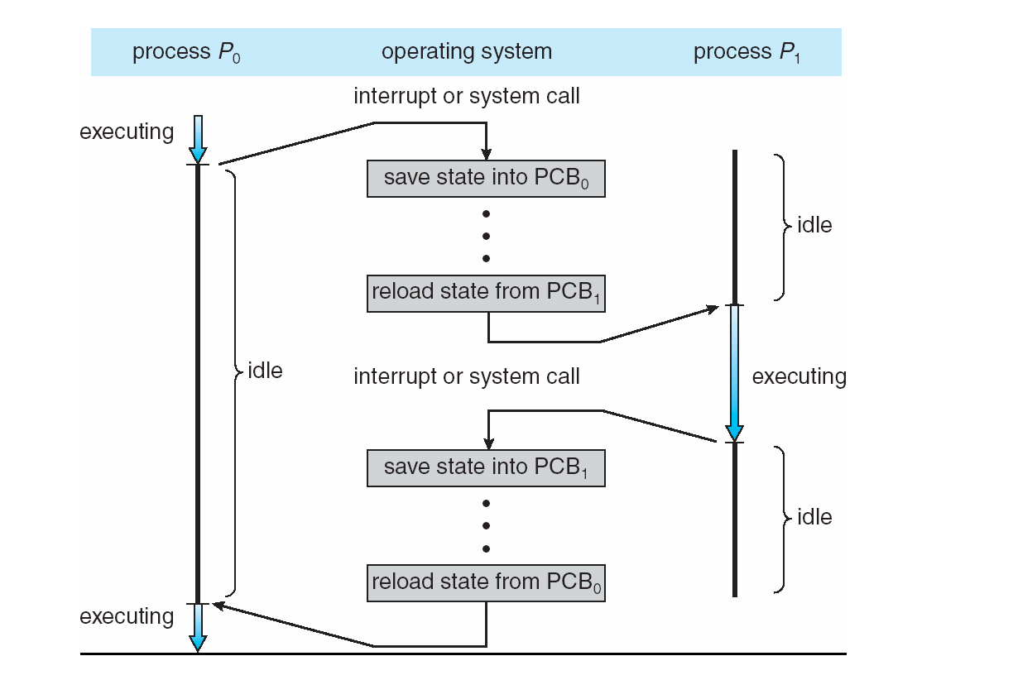
Context Switch between Processes

Slide 16
When to Switch a Process
Interrupts
Clock → process has executed a full time-slice
I/O
Memory fault
memory address is in virtual memory
More on this later
System call
Exception
When error occurred

Slide 17
Communication between Processes
Sometimes processes want to cooperate with each other:
E.g. share information, break large task into multiple tasks
On the other hand, processes should be protected from each other
→ Inter-process communication (IPC) is provided by the OS, through specific system calls → very high overhead

Slide 18
Inter-process Communication (IPC)
Many ways to achieve that:
Specify a segment in the memory that is shared, and all processes can access it
Many times implemented through the file system
One writes to a file, one reads from it
Exchanging messages through communication channel (e.g., the socket interface)
Sometimes classified to either shared-memory or message-passing systems
Create a lot of problem of synchronization

Slide 19
NEXT CONCEPT: THREADS

Slide 20
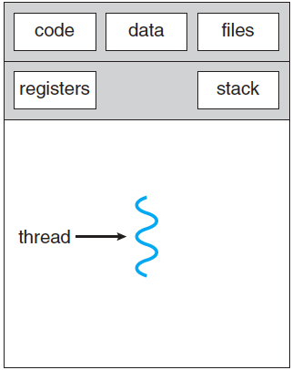
Thread of Control
Thread: Single unique path of execution
Up until now, each process had one thread of control

Slide 21
Examples of Concurrent Tasks
Many applications need to perform more than one task at once
Web browser: retrieve data from the network; display images of data already retrieved
Word processing: process keystrokes; display graphics; perform spell check on the background
Web server: process many requests while listening to new requests

Slide 22
How to do these tasks concurrently?
No concurrency: the word processor will wait on a keystroke → evicting the CPU → No other of its tasks will run until the keystroke is processed after a keyboard interrupt
Each task as a process:
A lot of IPC → Very clumsy, expensive, slow.
The code of the program is in memory again and again (e.g., for each web request)

Slide 23
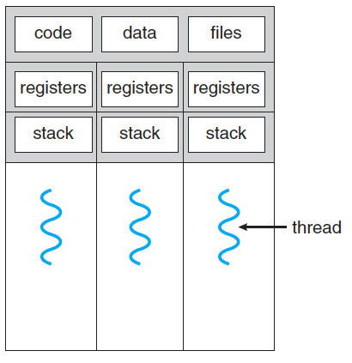
Multi-threaded Processes
Each thread has its own registers (including PC) and stack
All threads share
The code of the program
All other data (global variables and the heap)
Files

Slide 24
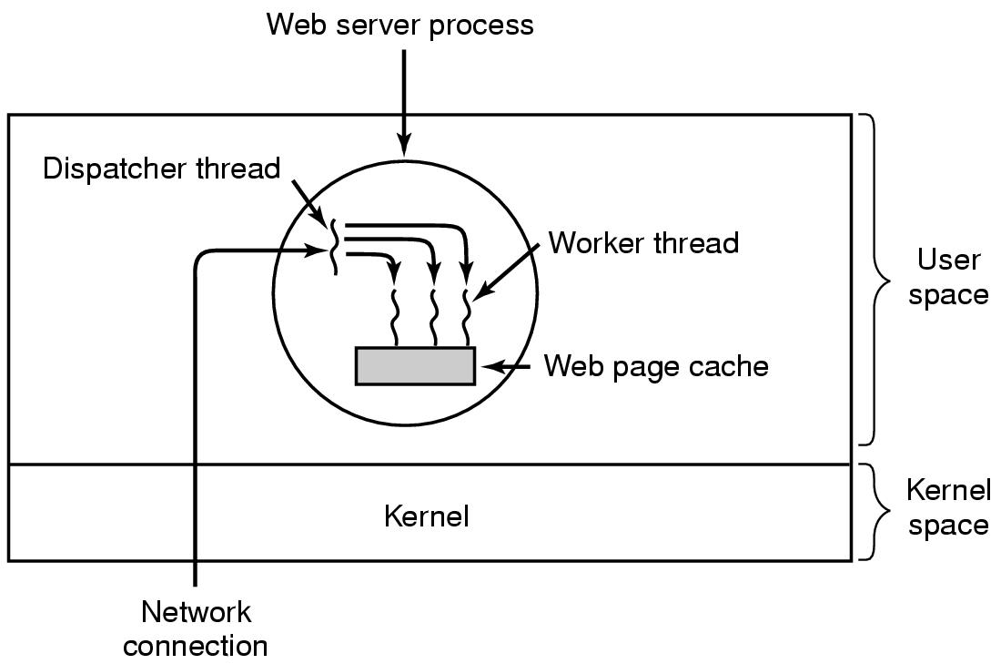
Example: A Multi-threaded Web Server

Slide 25
User-Level Threads
All thread management is done by the application
The kernel is not aware of the existence of threads
Thread switching does not require kernel mode privileges
Scheduling is application specific
Major Problems:
System calls (including I/O) by threads block the process
A single thread can monopolize the time-slice thus starving the other threads within the task

Slide 26
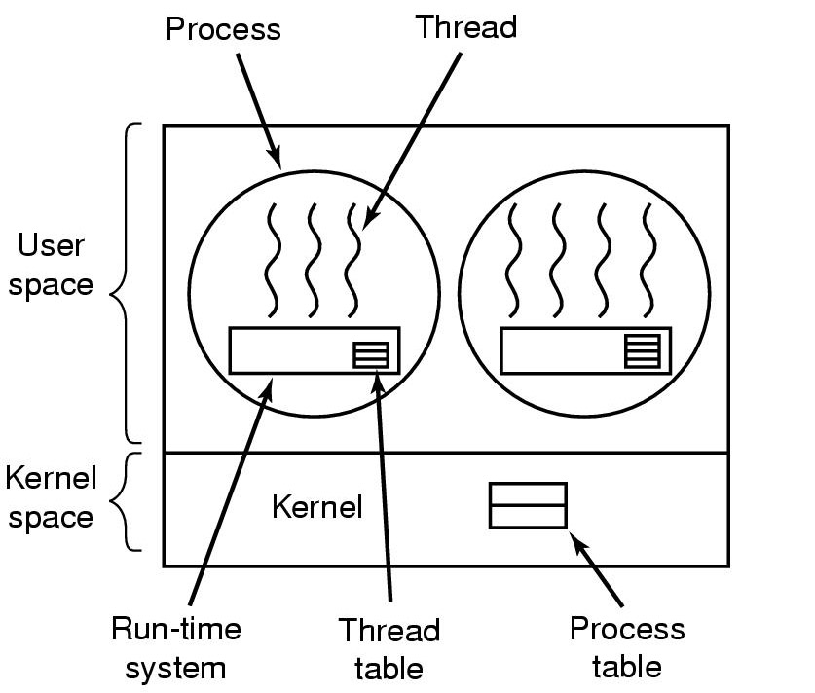
Implementing Threads in User Space
A user-level threads package

Slide 27
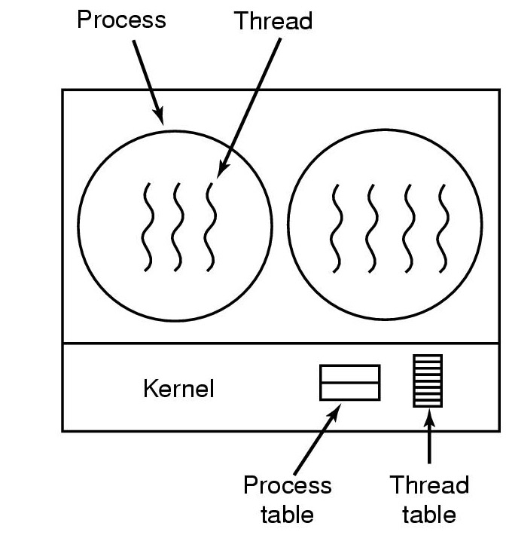
Implementing Threads by the Kernel
A threads package managed by the kernel (very similar to processes)
The threads of a process appear in the process’s PCB

Slide 28
Kernel-level Threads
Kernel maintains context information for the process and the threads
Blocking a thread does not have to block the process
Disadvantage: Switching between threads requires the kernel
Terminology:
Kernel-level threads are managed by the kernel but run in user space
Kernel threads are managed by the kernel and run in kernel space

Slide 29
Real-life Examples
User-level Threads Libraries:
POSIX Pthreads (Common in UNIX operating systems).
Mach C-threads
Solaris threads
Windows 7 UMS
Kernel-level Threads:
Windows
Solaris
Linux (through clone() system call).

Slide 30
Summary: Benefits of Threads
30-100 times faster to create a new thread than a process
Less time to terminate a thread than a process
~5 times faster to switch between two threads within the same process
Threads within the same process share memory and files ➔ they can communicate without invoking the kernel

Slide 31
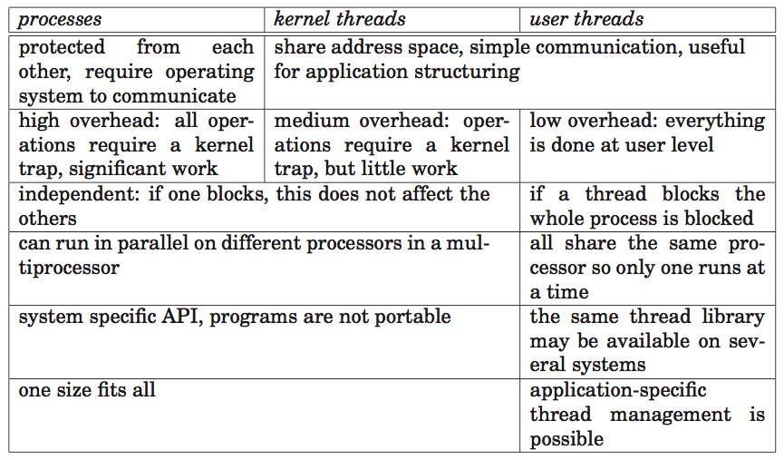
Summary: Threads vs. Processors

Slide 32
Is the CPU aware of the existence of:
User-level threads
kernel-level threads
Both user- and kernel-level threads
Neither user- nor kernel-level threads

Slide 33

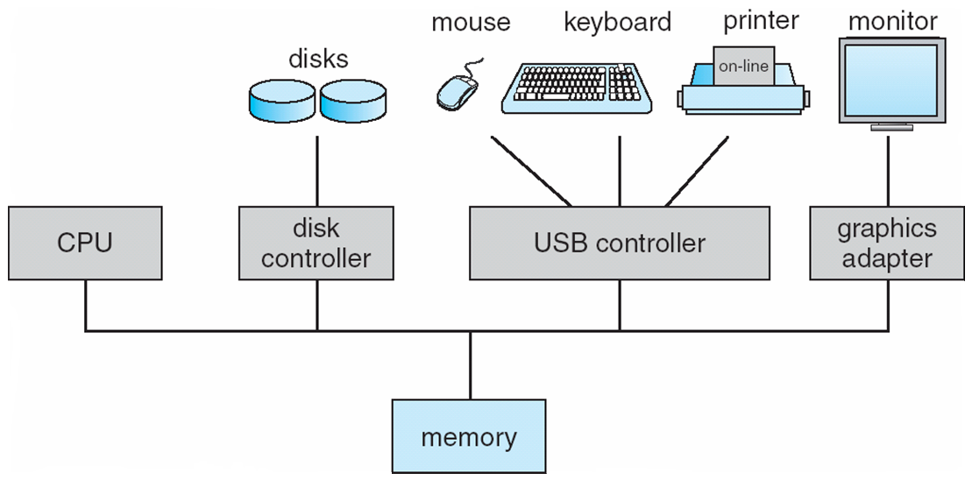
User- and Kernel Level-Threads
User
User
User
User
USER-LEVEL
KERNEL-LEVEL
Applications
Operating System

Slide 34
Real Parallelism in Hardware: Multi-processors and multi-core
Up until now, we showed a single CPU capable of performing a single instruction at a time
In modern CPU sometimes there is some parallelism in HW
One can put more than one CPU on the same motherboard to achieve real parallelism
But a lot of over-head
Exists mostly in servers nowadays
Lighter version (and the most popular): multi-core CPU

Slide 35
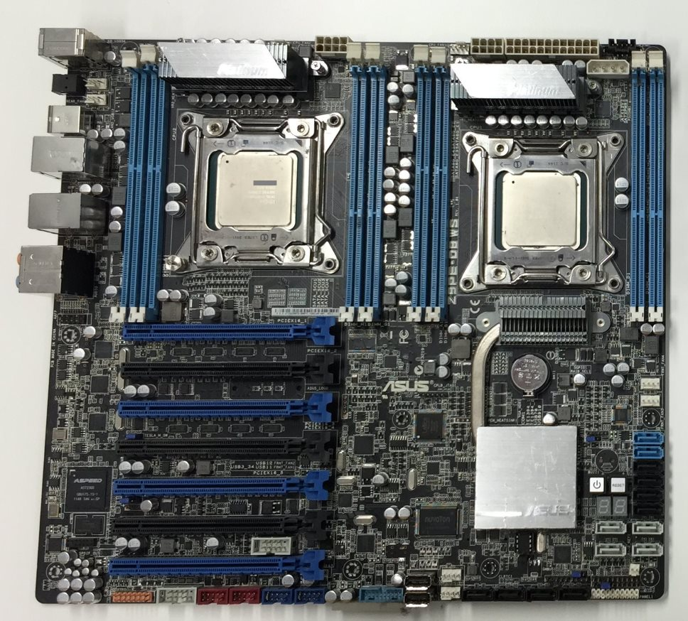
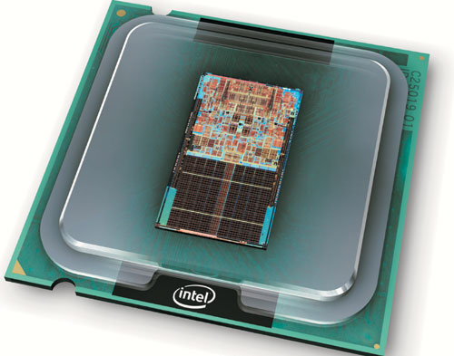
Multiprocessors / Multicores

Slide 36
Multi-core processors
Processor 1 Processor 2
The OS must be aware on the number of processors and cores
Each core executes a different, independent instruction
Logically, cores and processors differ in the level of memory they share and the cost of communication between them
Physically, there are more differences
Core
Core
Core
Core
L1
L1
L1
L1
Switch
Switch
L2
L2
Memory
Two processors with two cores and shared memory

Slide 37
“Hardware-Level” Threads: Hyper-Threading
Intel’s technology since Pentium 4 (2002)
Single-core, single-processor
Appears to the OS as if there are several CPUs, although there is one
Management, switching between the hyper-threads is done by the CPU in hardware
More efficient than kernel-mode threads
Today, usually hyper-threading provide 2 hyper-thread for each core
4-core machine with hyper-threading appears to the OS as 8-core machine

Slide 38
SYNCHRONIZATION

Slide 39
Motivation: Two processes (or threads) want to print
Both processors write their job to the spooler – the queue for with the printer extracts job to print.
NULL: No job to print
OUT: Next job to print
IN: End of queue, write new job here
Code for each process: Spooler[IN] = job IN++
1
A
2
B
2
3
C
OUT
4
NULL
5
NULL
6
NULL
4
7
NULL
IN

Slide 40
Possible Outcomes 1/2
Process 1: Spooler[IN] = JOB1
Process 1: IN++
<Context Switch by OS>
Process 2: Spooler[IN] = JOB2
Process 2: IN++
1
A
2
B
2
3
C
NULL
OUT
4
JOB1
NULL
5
JOB2
6
NULL
6
7
NULL
5
4
IN

Slide 41
Possible Outcomes 2/2
Process 1: Spooler[IN] = JOB1
<Context Switch by OS>
Process 2: Spooler[IN] = JOB2
<Context Switch by OS>
Process 1: IN++
<Context Switch by OS>
Process 2: IN++
→ JOB1 is lost; all jobs after JOB2 may not be printed as well, because of the gap
1
A
2
B
2
3
C
NULL
JOB2
OUT
4
JOB1
5
NULL
6
NULL
6
7
NULL
5
4
IN

Slide 42
Further Motivation
100-1000
Global variable IN is in address 100
IN++
lw r1, 100
inc r1
sw 100, r1

Slide 43
Further Motivation
100: 2
100: 1
100: 0
100: 1
100: 0
Thread 1: lw r1,100
Thread 1: inc r1
Thread 1: sw 100,r1
<Context Switch>
Thread 2: lw r1, 100
Thread 2: inc r1
Thread 2: sw 100, r1
Thread 1: lw r1,100
Thread 1: inc r1
<Context Switch>
Thread 2: lw r1, 100
Thread 2: inc r1
Thread 2: sw 100, r1
<Context Switch>
Thread 1: sw 100,r1
lw r1, 100
inc r1
sw 100, r1
r1: 1
r1: 0
r1: 2
r1: 1
r1: 0
→ IN = 2
→ IN = 1

Slide 44
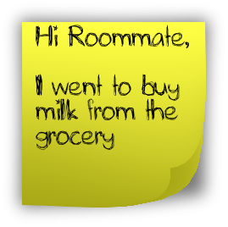
“Too Much Milk”…
Time | You | Your Roommate
3:00 | Arrive Home
3:05 | Look in fridge; no milk
3:10 | Leave for grocery
3:15 |  | Arrive home
3:20 | Arrive at grocery | Look in fridge; no milk
3:25 | Buy milk | Leave for grocery
3:35 | Arrive home; put milk in fridge
3:45 |  | Buy milk
3:50 |  | Arrive home; oh no!
Notes:
להוסיף פתק

Slide 45

What’s happening here?
The Problem: Uncoordinated access to a shared resource (data structure or device)
By multiple threads, by multiple processes, by multiple cores/processors
Where: Critical section is a piece of code that accesses the shared resource.
Can be one instruction or very large code
Correctness: must not be concurrently executed by more than one thread process.
Solution: Mutual exclusion algorithms are used to avoid the simultaneous execution of a critical section
Important: Sometimes it is not enough to ensure mutual exclusion (e.g., when the order of execution matters)
More on this later
In HUJI:
67520 Distributed Algorithms course
Given by Prof. Danny Dolev
(Usually in Semester A)

Slide 46
Modeling the Mutual Exclusion Problem [First modeling by Dijkstra, 1965]
Remainder Code
The Problem: Write entry and exit code to
ensure the following four properties
Mutual Exclusion: No two processes are in their critical section at the same time.
Progress: If a process in trying to enter the critical section then some process must eventually enter the critical section.
Starvation freedom: If a process in trying to enter the critical section then this process must eventually enter the critical section.
Generality: no assumptions may be made about speeds or the number of participants (threads/processes/cores/CPUs)
No blocking in the reminder No process running outside its critical section may block other process
Entry Code
Critical Section
Exit Code

Slide 47
First Try: Disabling interrupts
Satisfies Properties 1,2,3,5 but:
Does not solve the problem in a multi-processor system (where real parallelism exists)→ Property 4 is violated
And:
User processes should not be allowed to disable interrupts
Disabling interrupts should be done for a very short period of time
Remainder Code
Entry Code:
Disable Interrupts
Hidden assumption for all algorithms: Processes never terminate in the critical section and finish it in finite time
Critical Section
Exit Code:
Enable Interrupts
47

Slide 48
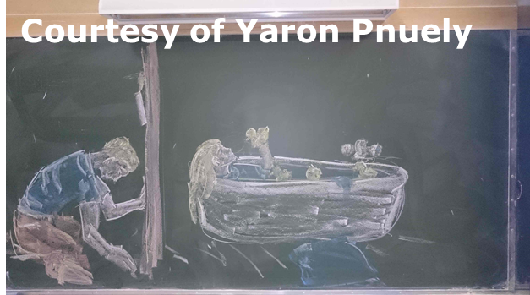
Critical Section

Slide 49
No “Cheating” – First Try
Reminder
Reminder
Algorithm for 2 threads/processes
Uses global variable (1 bit) named turn. Cannot be used in the reminder/critical
(Slightly) different code for each thread
while(turn==1);
while(turn==0);
Critical
Critical
turn=1;
turn=0;
Code for Thread 0
Code for Thread 1

Slide 50
No “Cheating” – First Try
Reminder
Reminder
Bad News:
Progress / no blocking in the reminder does not hold. Thread 1 can simply stay in its reminder and never get to its entry (and therefore exit) code → Starvation Freedom does not hold
while(turn==1);
while(turn==0);
Critical
Critical
turn=1;
turn=0;
Code for Thread 0
Code for Thread 1
√ Mutual Exclusion: Assume that the two of the processes are in the critical condition, and then w.l.o.g. thread 0 left its entry section (and entered the
critical section) first → At that point, turn≠1→turn=0. The only place turn can be changed to 1 is when thread 0 exits the critical section, thus turn=0 throughout the entire execution of the critical section by Thread 0→Thread 1 is in its entry code when Thread 0 is the critical section → Contradiction.

Slide 51
No “Cheating” – Second Try
Reminder
Reminder
No Blocking in the Reminder: A thread can block another thread only if its flag is true, implying it is either in its entry, critical, or exit section.
flag[0] = true;
while(flag[1]);
flag[1]=true;
while(flag[0]);
Critical
Critical
flag[0]=false;
flag[1]=false
But still Progress does not hold
→ Starvation Freedom does not hold
Deadlock!
Code for Thread 0
Code for Thread 1
√ Mutual Exclusion: Assume that the two of the processes are in the critical section, and then w.l.o.g. thread 0 left its entry section (and entered the
critical section) first → At that point, flag[0]=true → The only place flag[0] can be changed to false is when thread 0 exits the critical section, thus flag[0]=true throughout the entire execution of the critical section by Thread 0→Thread 1 is in its entry code when Thread 0 is the critical section → Contradiction.

Slide 52
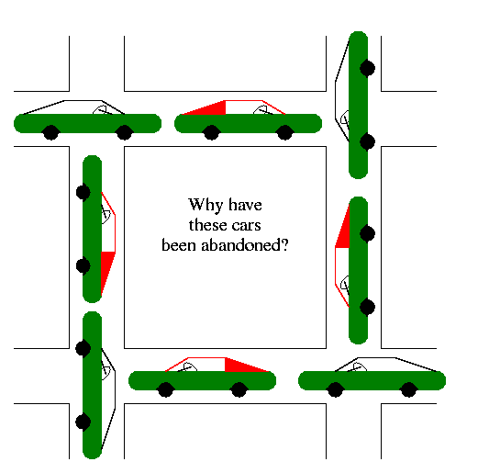
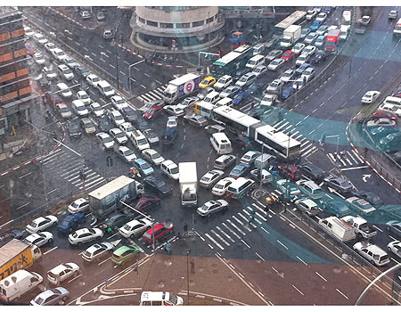
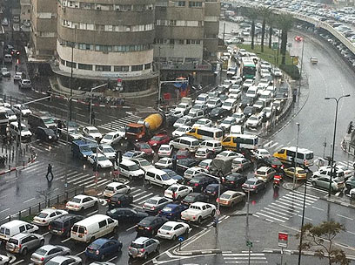
Illustration of Deadlocks
Tel Aviv, Winter 2011

Slide 53
No “Cheating” – Third Try
Reminder
Reminder
turn=1;
flag[0] = true;
while(flag[1] and turn==1);
turn=0;
flag[1] = true;
while(flag[0] and turn==0);
Critical
Critical
flag[0]=false;
flag[1]=false
Code for Thread 0
Code for Thread 1
Mutual Exclusion does not hold

Slide 54
Peterson’s Algorithm - 1981
Reminder
Reminder
Reminder
flag[i] = true;
turn=1-i;
while(flag[1-i] and turn==1-i);
flag[1] = true;
turn=0;
while(flag[0] and turn==0);
flag[0] = true;
turn=1;
while(flag[1] and turn==1);
Critical
Critical
Critical
Flag[i]=false;
flag[1]=false
flag[0]=false;
Code for Thread i
Code for Thread 1
Code for Thread 0
√ Mutual Exclusion: Assume that the two of the processes are in the critical condition, and then w.l.o.g. thread 0 left its entry section (and entered the
critical section) first → At that point, flag[1]=false or turn=0.
Case 1: flag[1]=false → Thread 1 has not executed Line 1 of it’s entry code → When it will eventually get to Line 3, it will set turn to 0, and wait. The only place turn is set to 1, is in Thread’s 0 entry code, after it left the critical section → Contradiction.
Case 2: turn=0→Thread 1 executed Line 2 between Thread 0 Line 2 and 3→
54

Slide 55
Peterson’s Algorithm - 1981
Reminder
√ No blocking in the Reminder
√ Starvation Free: Assume Thread 1 tries to get into the critical section but blocked (on Line 3) for infinite time → Thread 0 enters the critical section infinite number of times → The second time Thread 0 will execute the entry, flag[0]=true, turn=1 and it will block → The next time Thread 1 gets the CPU, the while condition does not hold and Thread 1 enters the critical section → Contradiction.
flag[i] = true;
turn=1-i;
while(flag[1-i] and turn==1-i);
Critical
Flag[i]=false;
Two threads only cannot be easily extended to more
Busy wait (spinning)
Code for Thread i
√ Mutual Exclusion: Assume that the two of the processes are in the critical condition, and then w.l.o.g. thread 0 left its entry section (and entered the
critical section) first → At that point, flag[1]=false or turn=0.
Case 1: flag[1]=false → Thread 1 has not executed Line 1 of it’s entry code → When it will eventually get to Line 3, it will set turn to 0, and wait. The only place turn is set to 1, is in Thread’s 0 entry code, after it left the critical section → Contradiction.
Case 2: turn=0→Thread 1 executed Line 2 between Thread 0 Line 2 and 3→
55

Slide 56
Three Concepts We’ve Covered
Race Condition: A situation in which the scheduling of processes/threads (the order of who is getting the CPU) changes the final result
Different order → different results
Typical scenario: Most of the time everything is OK, but sometime not → very hard to debug
Atomic Instruction: instruction that completes in a single step relative to other threads
x=x+1 was not atomic
Read (lw) and write (sw) were atomic
Sometimes this doesn’t hold (wide words that spans more than one memory address)

Slide 57
Three Concepts We’ve Covered
Busy-waiting (spinning, busy-looping): technique in which a process repeatedly checks to see if a condition is true
“do nothing” loops: while(flag[1-i] and turn==1-i);
Usually, should be avoided as it wastes CPU cycles and yields large overhead
Polling vs. interrupts
We will discuss alternative later

Slide 58





Lamport’s Bakery Algorithm - 1974
1
2
3
4
5
n
0
0
0
0
0
0
0
Reminder
0
0
1
2
3
2
Take a number
4
entry
Wait your turn
1
2
3
2
4
Critical
1
2
2
time
exit
1
2
2

Slide 59
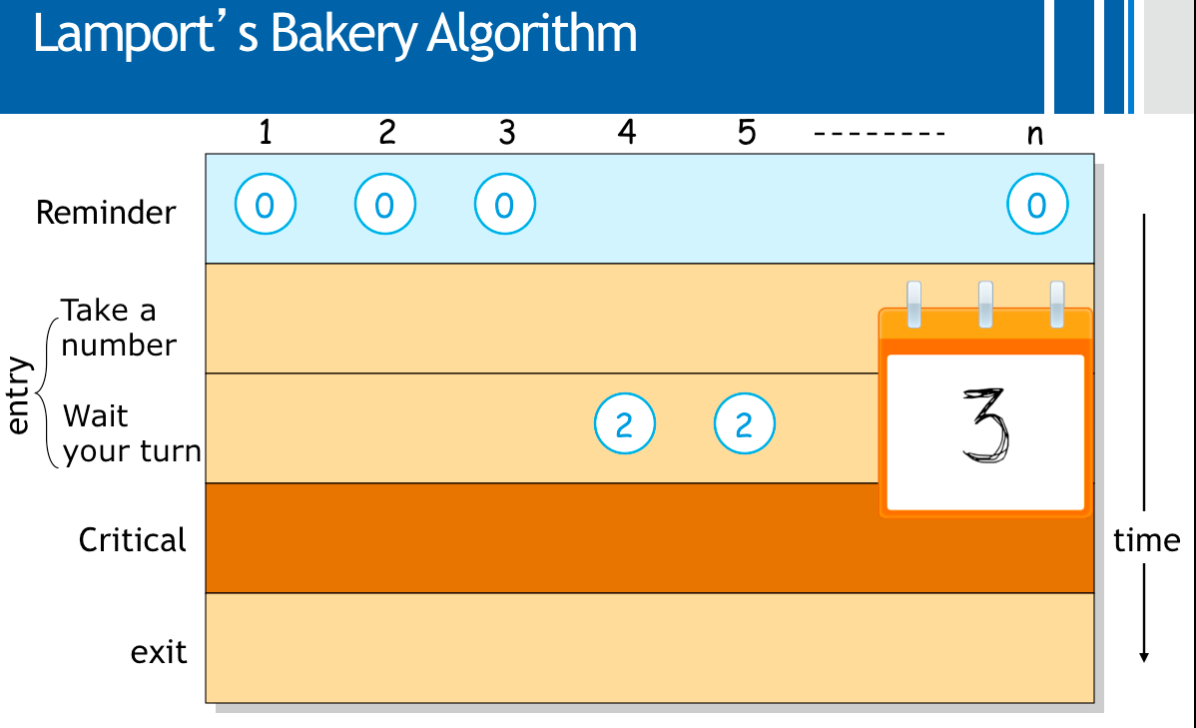
Implementation 1
Reminder
number[i] = 1+max_{j∈ {1,…,n}}{number[j]};
for j=1 to n {
while(i≠j and number[j]>0 and number[j]<number[i]);
}
Deadlock!
Critical
number[i]=0;
Code for Thread i (out of n threads)

Slide 60
Implementation 2
Reminder
Read all values
Compute maximum
Store value
number[i] = 1+max_{j∈ {1,…,n}}{number[j]};
for j=1 to n {
while(i≠j and number[j]>0 and (number[j],j)<(number[i],i));
}
Critical
Lexicographic order
number[i]=0;
Code for Thread i (out of n threads)

Slide 61
Bakery Algorithm – Implementation 2
1
2
3
4
5
n
0
0
0
0
0
0
Reminder
0
0
0
0
Take a number
0
2
0
entry
2
2
time
Wait your turn
2
Computes number: 2 but still doesn’t write to memory.
2
Critical
2
2
exit

Slide 62
Correct Implementation (1974)
Reminder
Choosing[i]=true;
Number[i] = 1+max_{j∈ {1,…,n}}{number[j]};
Choosing[i]=false;
for j=1 to n {
while(Choosing[j]);
while(i≠j and number[j]>0 and (number[j],j)<(number[i],i));
}
It is important not to write to memory when computing maximum
Critical
number[i]=0;
Also ensures a notion of First-In-First-Out:
If a process i is waiting (somewhere in the for loop) and thread j has not yet started the entry, then j will not enter the CS before i.
Code for Thread i (out of n threads)
Notes:
Also ensures a notion of FIFO: if process i is waiting and thread j has not yet started the entry, then j will not enter the CS before i.

Slide 63
Read-Modify-Write Instructions
Up until now we assume that read (load) and write (store) are atomic instructions
There might be a context switch between a read and its corresponding write
Modern CPUs support in hardware some RMW instructions:
Test&Set(&lock):
{i=*lock; *lock=1; return i;}
Fetch&Add(&p,inc):
{val=*p; *p=val+inc; return val}
Compare&Swap(&p,old,new):
{if(*p≠old) return false; *p=new; return true;}

Slide 64
Mutual Exclusion with Test&Set
Reminder
while(test&set(lock));
Critical
lock=0;
Code for Thread i
Not so fast: Starvation Freedom condition does not hold!

Slide 65
Burn’s Algorithm
Reminder
waiting[i]=true;
key[i]=1;
while(waiting[i] and key[i]) { key[i]=test&set(lock) };
waiting[i]=false;
Critical
j=i+1 mod n;
while(j≠i and not waiting[j]) {
j=j+1 mod n };
if(j≠i) { waiting[j]=false;}
else {lock=0;}
Code for Thread i out of n

Slide 66
Up until now…
We saw several solution for the mutual exclusion problem in different settings
All the solutions perform busy-waiting:
Waste of CPU resources
Mutual exclusion is only one synchronization problem. There are many more
Contention → coordination
Some will be covered in the tutorials

Slide 67
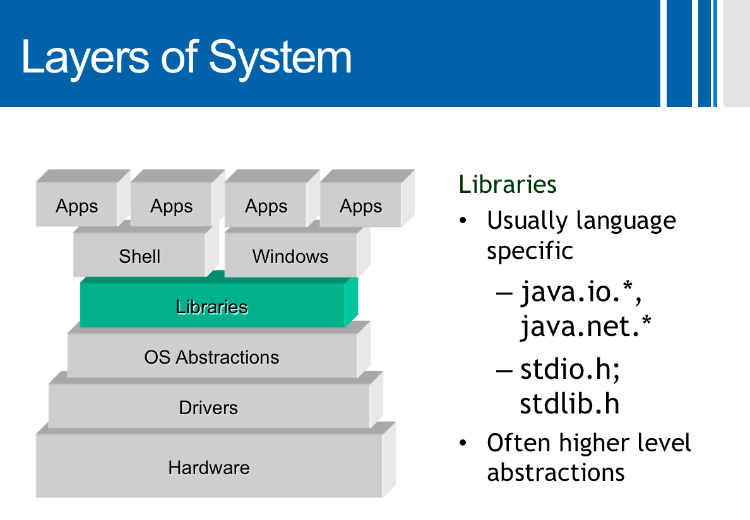
Next: Synchronization Primitives
We will define abstract data types used to provide synchronization
Clear interface to the data type
The data type (and its inner variables) cannot be accessed in any other way
Usually provide by the programming language with some support of the OS
The abstract data type may have many implementations

Slide 68

First Data Type: Semaphore
Record with two fields:
- value
List (L)
Two operations:
The operations are executed atomically
How? Implementation is orthogonal to the definition
In literature, the operations are often called P(s) and V(s).
In the book, wait(s), signal(s)
Some variations bound the maximum and minimum value (e.g., binary semaphores)
In literature, the operations are often called P(s) and V(s)
Down(S)
S.value= S.value - 1
if S.value < 0 then
{ add this thread to S.L;
sleep();}
Up(S)
S.value= S.value + 1
if S.value≤0 then
{remove a thread T from S.L; Wakeup(T);}
Init(S,v)
S.value= v

Slide 69
Mutual Exclusion w/ Semaphore
Reminder
Assume lock is a shared semaphore
Initially lock is 1
Value:
Cannot be more than 1
0: one process in Critical Section
(-x): x processes are waiting
All properties hold
If L is a FIFO queue
lock.value= lock.value - 1
if lock.value < 0 then
{ add this thread to S.L;
sleep();}
down(lock)
Critical
up(lock)
lock.value= lock.value + 1
If lock.value≤0 then
{remove a thread T from S.L; Wakeup(T);}
Code for Thread i
0/1 (binary) semaphore suffices → Binary semaphores data type are often called Mutex objects

Slide 70
“Execute A after B”
A different synchornization problem
Cooridnation rather than contention
One process needs to execute code A, before another process executes code B
….
….
down(flag)
A
B
Semaphore flag, initialized to 0
up(flag)
….
….
Process 1
Process 2

Slide 71
Semaphores are not Silver Bullets
Although it is much easier to work with semaphore than read/write operations, it is still possible to cause problems (e.g., deadlocks, starvation, incorrectness)
Thread 1 moves money from account A to B, Thread 2 moved money from B, A
….
….
Deadlock!
down(SA)
down(SB)
down(SB)
down(SA)
Move A→B
Move B→A
Semaphore SA, initialized to 1
Semaphore SB, initialized to 1
up(SA)
….
up(SB)
….
up(SB)
up(SA)
Thread 1
Thread 2

Slide 72
Semaphores are not Silver Bullets
Although it is much easier to work with semaphore than read/write operations, it is still possible to cause problems (e.g., deadlocks, starvation, incorrectness)
Thread 1 moves money from account A to B, Thread 2 moved money from B, A
….
….
down(SA)
down(SA)
down(SB)
down(SB)
Move A→B
Move B→A
Semaphore SA, initialized to 1
Semaphore SB, initialized to 1
up(SB)
….
up(SB)
….
up(SA)
up(SA)
Thread 1
Thread 2

Slide 73
Dining Philosophers
Philosophers
think
take forks
eat
put forks
Eating needs 2 forks
Pick one fork at a time
How to prevent deadlock
6 philosophers & 6 forks

Slide 74
Nonsolution
down(chopstick[(i+1)mode 6])
down(chopstick[(i])
Eat
Initially, all semaphores are 1
up(chopstick[(i+1)mode 6])
up(chopstick[(i])
Think

Slide 75
An incorrect solution
P0
down(chopstick[(i+1)mode 6])
P5
down(chopstick[(i])
P1
Eat
f0
f1
up(chopstick[(i+1)mode 6])
up(chopstick[(i])
f5
Think
Deadlock!
f2
f4
f3
P4
P2
( means “first forks taken”)
( means “waiting for this forks”)
P3

Slide 76
One Solution
The solution
A philosopher first gets
only then it takes the 2 forks.
An inefficient solution
reduce to mutual exclusion
not enough concurrency

Slide 77
Better Solution: Breaking Symmetry (a.k.a. the LR solution)
Odd threads
Even threads
down(chopstick[(i+1)mode 6])
down(chopstick[(i+1)mode 6])
down(chopstick[(i])
down(chopstick[(i])
down(chopstick[(i])
down(chopstick[(i+1)mode 6])
Eat
Eat
up(chopstick[(i+1)mode 6])
up(chopstick[(i+1)mode 6])
up(chopstick[(i])
up(chopstick[(i])
Think
Think
Provides progress (no deadlock) and starvation freedom.
It is enough to single out only one philosopher (e.g. Philosopher 5)

Slide 78
Next Week
More Classical Synchornization Problems
The Dinning Philosophers Problem
The Producer-Consumer Problem
The Readers and Writers Problem
More Synchronization Primitives

